Slide 1
An Introduction to Software Engineering

Slide 2
Objectives
7
To introduce software engineering and to explain its importance
To set out the answers to key questions about software engineering
To introduce ethical and professional issues and to explain why they are of concern to software engineers

Slide 3
Topics covered
8
Software Engineering
Software Costs
FAQs about software engineering

Slide 4

FAQs about software engineering
12
What is software?
What is software engineering?
What is the difference between software engineering and computer science?
What is a software process?
What is a software process model?

Slide 5
FAQs about software engineering
13
What are the costs of software engineering?
What are software engineering methods?
What are the attributes of good software?
What are the key challenges facing software engineering?

Slide 6
Case Study: NASA Mars Climate Orbiter
Mission failed due to a software error in unit conversion
- Highlights the importance of precision and testing in software engineering

Slide 7


What is software?
14
Set of instruction for computer to perform some task
Computer programs and associated documentation such as requirements, design models and user manuals.
Software products may be developed for a particular customer or may be developed for a general market.
Software products may be
▫ Generic - developed to be sold to a range of different customers e.g. PC
software such as Excel or Word.
▫ Bespoke (custom) - developed for a single customer according to
their specification.

Slide 8
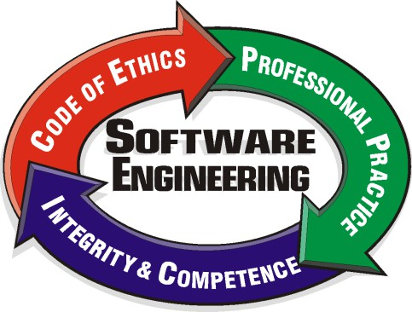
What is software engineering?
15
Software engineering is an engineering discipline that is concerned with all aspects of software production.
Software engineers should adopt a systematic and organised approach to their work and use appropriate tools and techniques depending on the problem to be solved, the development constraints and the resources available.

Slide 9

Software costs
10
Software costs often dominate computer system costs. The costs of software on a PC are often greater than the hardware cost.
Software costs more to maintain than it does to develop. For systems with a long life, maintenance costs may be several times development costs.

Slide 10
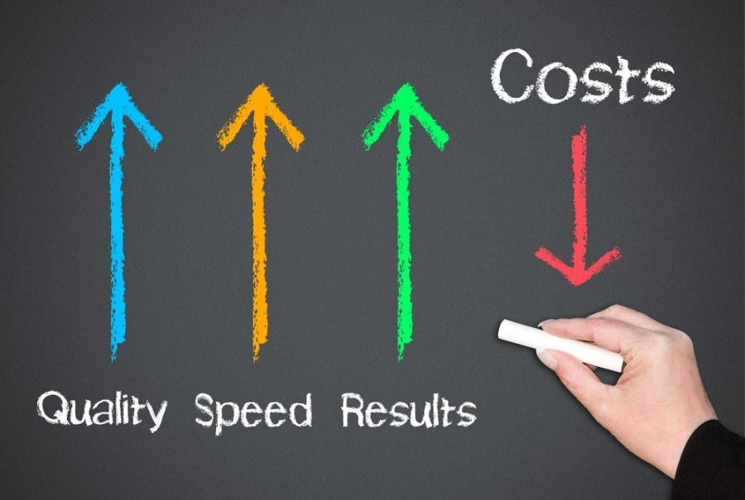
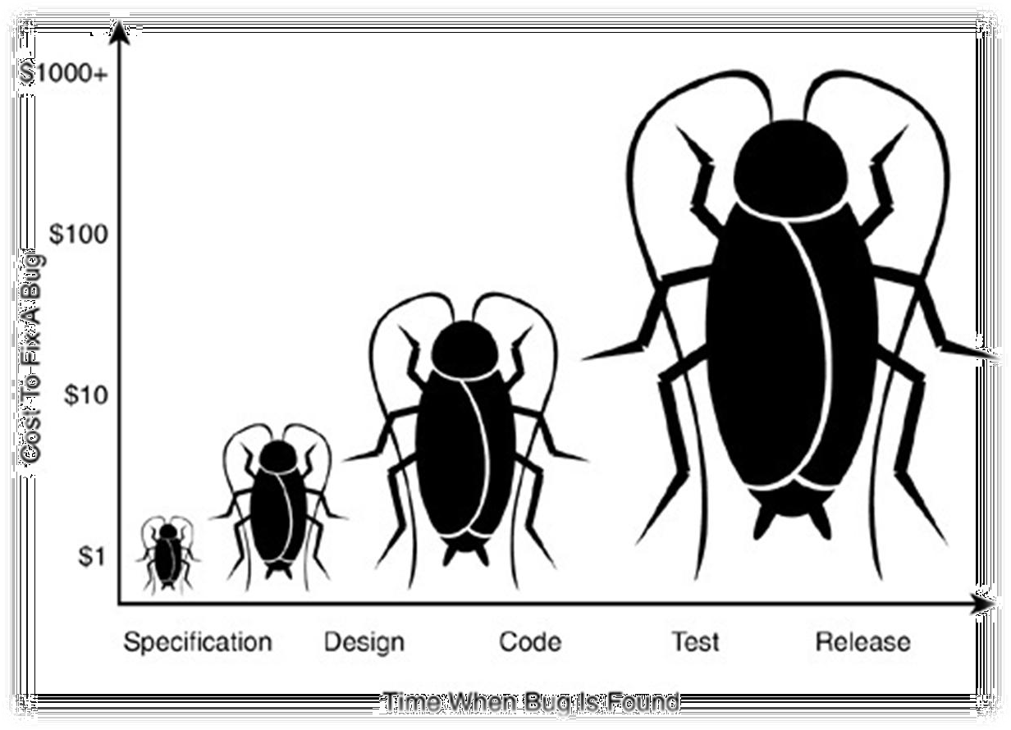
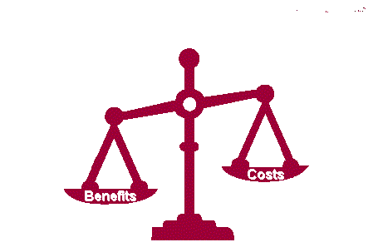
Software costs
11

Slide 11
What is the difference between software engineering and computer science?
16
Computer science is concerned with theory and fundamentals; software engineering is concerned with the practicalities of developing and delivering useful software.

Slide 12
Software Complex vs Complicated
18
Complex ≠ complicated
Complex = composed of many simple part related to one another
Complicated = not well understood, or explained

Slide 13
Example
20
Students
Any real world example ?

Slide 14




The Role of Software Engg. (1)
21
A bridge from customer needs to programming implementation
Customer
Programmer
First law of software engineering
Software engineer is willing to learn the problem domain
(problem cannot be solved without understanding it first)

Slide 15




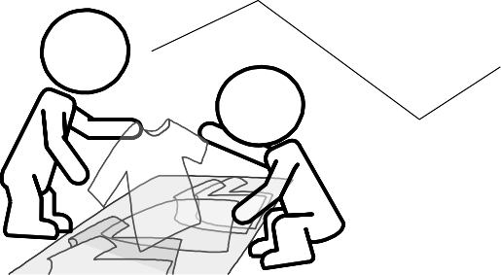
The Role of Software Engg. (2)
22
Customer:
Requires a computer system to achieve some business goals
by user interaction or interaction with the environment in a specified manner
System-to-be
Software-to-be
Environment
User
Software Engineer’s task:
To understand how the system-to-be needs to interact with
the user or the environment so that customer’s requirement is met and design the software-to-be
May be the same person
Programmer’s task:
To implement the software-to-be designed by the software engineer

Slide 16
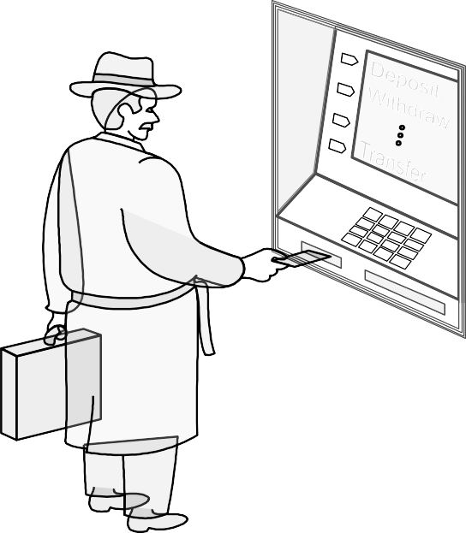
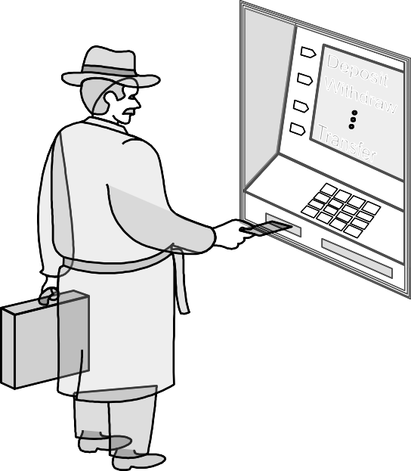
Example: ATM Machine
23
Understanding the money-machine problem:
1
2
Communication link
7
4
5
6
3
0
8 9
Bank’s remote datacenter
ATM machine
Bank customer

Slide 17

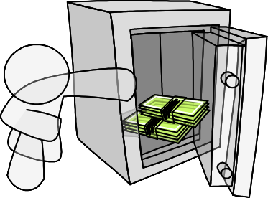






How ATM Machine Might Work
24
Domain model created with help of domain expert
Domain Model
Transaction record
How may I help you?
Cash
Speakerphone
Bookkeeper
Safe
Safe keeper
Phone
Window clerk
Datacenter liaison
Dispenser
Bank’s remote datacenter
Customer

Slide 18











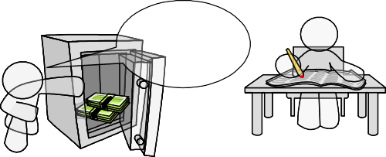
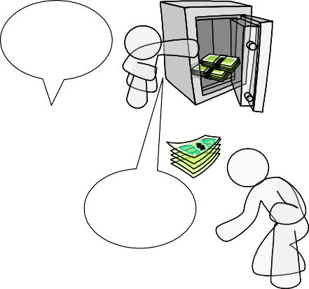









Cartoon Strip: How ATM Machine Works
25
A
Enter your PIN
B
Verify this account
C
Verify account XYZ
D
Account valid. Balance:
$100
Typing in PIN number
…
XYZ valid. Balance:
$100
E
How may I help you?
F
G
Record
$60 less
Release
$60
H
Dispensing!
Withdraw
$60
Dispense
$60
Please take your cash

Slide 19
Software Engineering Blueprints
26
Specifying software problems and solutions is like cartoon strip writing
Unfortunately, most of us are not artists, so we will use something less exciting:
UML

Slide 20
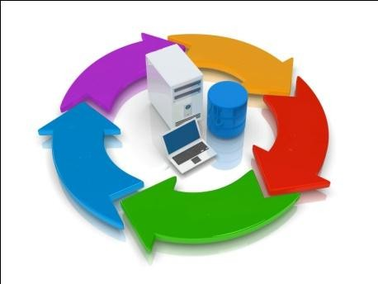
What is a software process?
28
A set of activities whose goal is the development or evolution of software.
Generic activities in all software processes are:
▫ Specification - what the system should do and its development constraints
▫ Development - production of the software system
▫ Validation - checking that the software is what the customer wants
▫ Evolution - changing the software in response to changing demands.

Slide 21
Software Development Life Cycle (SDLC)
28
Phases of SDLC:
Requirements Gathering
Specification
3. System Design
4. Implementation
5. Testing
6. Deployment
7. Maintenance

Slide 22
What are the costs of software engineering?
29
Roughly 60% of costs are development costs, 40% are testing costs. For custom software, evolution costs often exceed development costs.
Costs vary depending on the type of system being developed and the requirements of system attributes such as performance and system reliability.
Distribution of costs depends on the development model that is used.

Slide 23
Software Development Methods
31
Waterfall
  Unidirectional, finish this step before moving to the next
Incremental
  Develop increment of functionality, repeat in a feedback loop
Agile
  User feedback essential; feedback loops on several levels

Slide 24
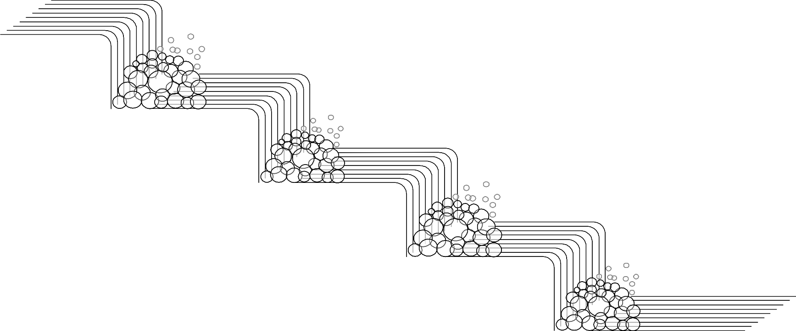
Waterfall Method
32
Requirements
Design
Implementation
Testing
Waterfall method
Deployment & Maintenance
Unidirectional, no way back
finish this step before moving to the next

Slide 25
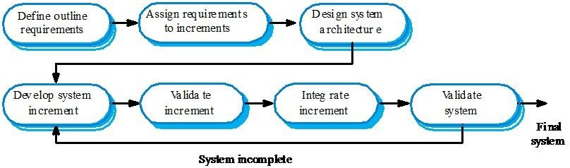
Incremental Method
33

Slide 26
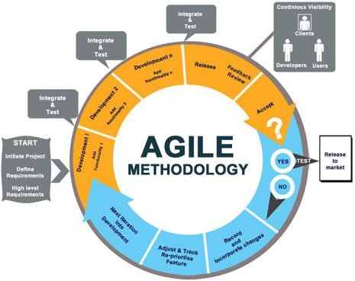
Agile Method
34

Slide 27
What is CASE (Computer-Aided Software Engineering)
35
Software systems that are intended to provide automated support for software process activities.
CASE systems are often used for method support.
Upper-CASE
▫ Tools to support the early process activities of requirements and design;
Lower-CASE
▫ Tools to support later activities such as programming, debugging and testing.

Slide 28
Any Questions?

